Slide 1
Moreton Says Grow the conversation to help shape our city

Slide 2
Acknowledgement of Traditional Custodians
City of Moreton Bay acknowledges the Jinibara, Kabi Kabi and Turrbal peoples and pays respects to Elders, past, present and emerging. Council recognises that the Moreton Bay region has always been a place of cultural, spiritual, social and economic significance to its Traditional Custodians. Council is committed to reconciliation and working in partnership with Traditional Custodians and Aboriginal and Torres Strait Islander communities to shape a shared future for the benefit of all communities within the City of Moreton Bay and beyond.

Slide 3
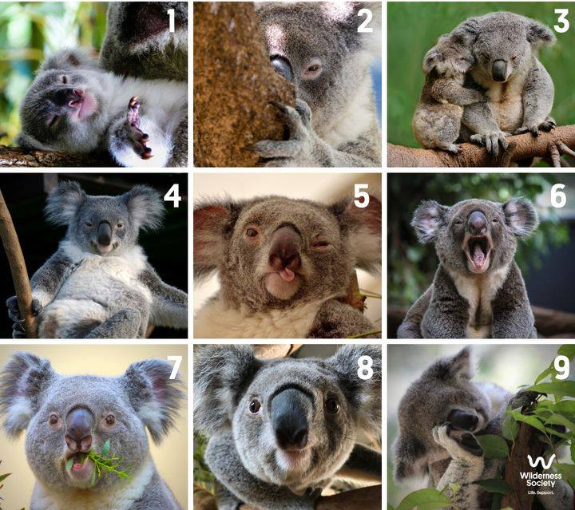
Koala Scale
On a scale of koala, when you hear words like
Council
Local Government
Mayor
Councillors
Citizens
how do you feel?
Notes:
Image credit: Facebook – The Wilderness Society

Slide 4
Outline
How does local government serve the community?
What’s the role of community engagement and role in Council decision-making?
Why is young people’s participation in Moreton Says important to inform decisions?

Slide 5
What level?
Do you know what level of government is responsible for what services?

Slide 6
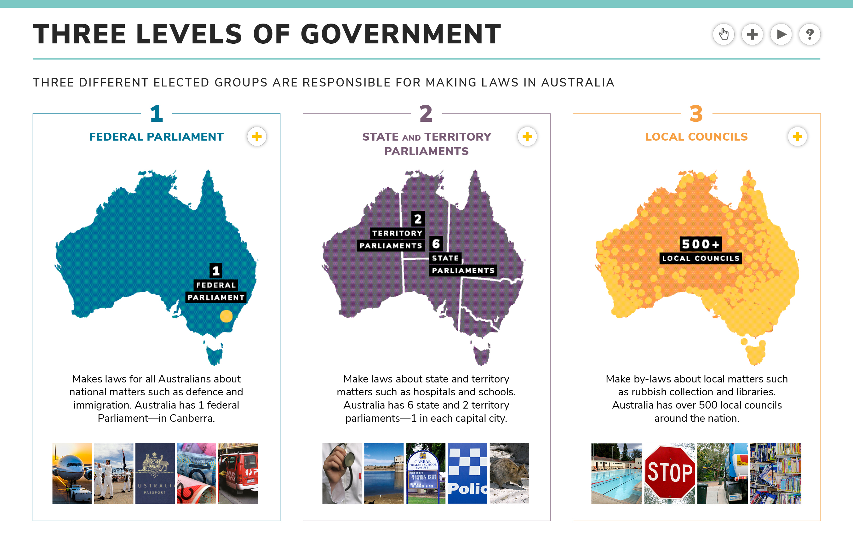
Federal Parliament
State and Territory Parliaments
Local Councils
Make laws for all Australians about national matters
Make laws about state and territory matters
Make by-laws about local matters
Mix & Match
In groups of 3, match the functions to the correct level of government.
You have five minutes to complete this activity

Slide 7
Federal Parliament
State and Territory Parliaments
Local Councils
Mix & Match
Currency
Foreign policy
Census and statistics
Immigration
Defence
Postal and telecommunication services
Taxation
Medicare
Schools
Hospitals
Public transport
Electricity and gas
Police and Ambulance
Mining
State roads and railways
Public housing
Local roads, footpaths, cycleways
Rubbish collection and recycling
Parks, sports fields and swimming pools
Libraries, art galleries and museums
Town planning
Building approvals and inspections
Pet control
Disaster management
How many did you get correct?

Slide 8
Your week?
Do you know what Council services you use?

Slide 9
Swam in a public swimming pool
Visited a public library
Been to a public playground
Put a finger down if…
Played sports at a sports complex
Visited a local park
Visited a public art gallery
Hold you hand up with fingers open. Put a finger down if you have done any of the following in the past week.
Put rubbish in a bin
Walked on a footpath
Travelled anywhere on a local road
We all use Council services are part of our daily lives. Some more than others and many that go unnoticed.

Slide 10
Your Values
What do you value most about where you live?

Slide 11
The natural beauty of the region
Access to services (e.g. health, schools, sport and recreation facilities)
How close you are to restaurants, cafes, and shops
Your Values
We each value different things about living in City of Moreton Bay.
Understanding what matters most to our communities enables Council to make informed decisions.
What do you value most about where you live?
Physical distance to your neighbours
How long it takes you to get to work or other regular destinations
Family-friendly activities and facilities (e.g. parks and playgrounds)
Ease of affording the lifestyle you want
How close you are to cultural experiences (e.g. Libraries, museums and performing arts)
An active lifestyle (i.e. being able to walk to places you go to often, exercise regularly)
How close you are to public transport

Slide 12
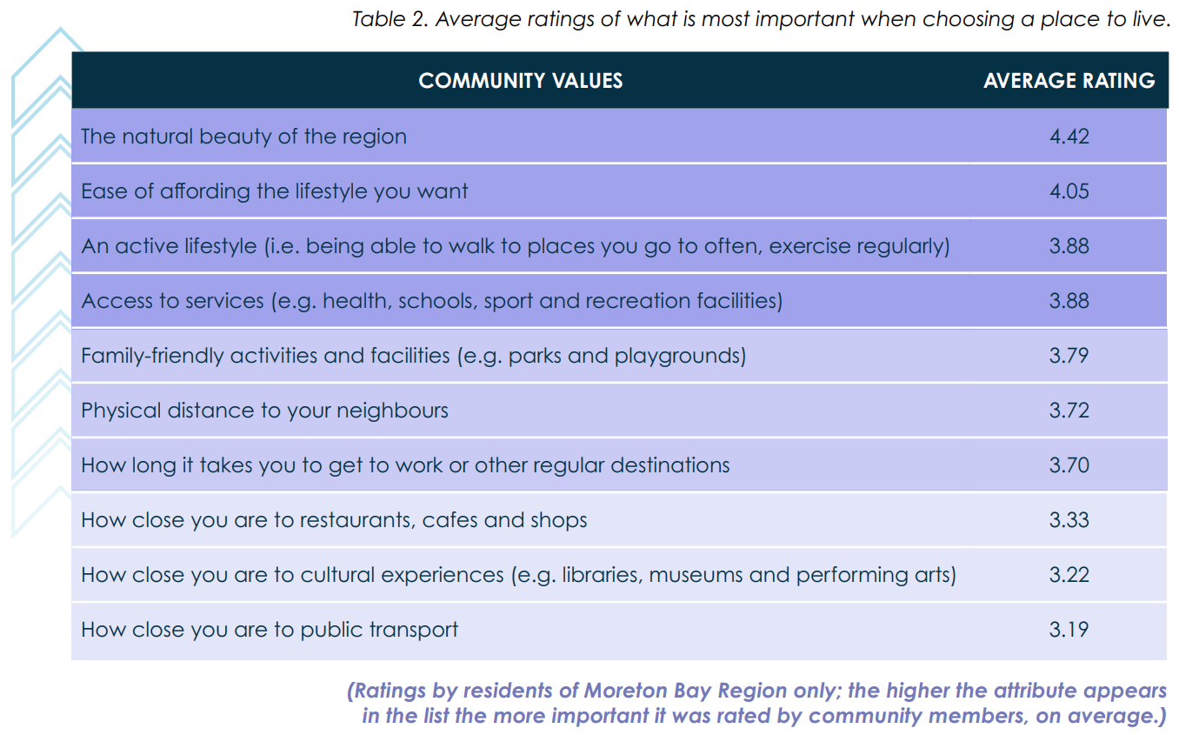
Comparing to the broader community
How do your values compare to City of Moreton Bay’s broader community?
This list is the average of how residents ranked these values in our 2021 Moreton Says survey
Ratings by residents of City of Moreton Bay only; the higher the value appears in the list the more important it was rated by community members on average

Slide 13
Moreton Says
Morton Says is Council’s major engagement program that is deliver across City of Moreton Bay twice per year. It helps Council capture feedback from people who live, work and visit the region on a wide range of topics.

Slide 14


Survey time!
Use this time to complete survey
Note:
All feedback is anonymous.
Filling in every question is important for ensuring quality data, so provide your best thoughts on the topic given what you currently know, even if you only know a bit about it.
moretonbay.link/ms-schools
This survey asks about:
Our city and council
Council services
Your community

